Slide 1
Brain tumors

Slide 2
Epidemiology
Incidence: 8-25/ 100.000
Metastasis – ¼ of all tumors

Slide 3
Etiology
Genetical predisposition
Hereditary factors – m. Recklinghausen (also brain tumors), tuberous sclerosis...)
Viral infections: Epstein-Barr virus - primary brain lymphoma
Environmental factors: pesticides, chemicals, Radiation

Slide 4
Secondary tumors I
Originate from malignant tumors located primarily in other organs
Lung
Skin - Malignant melanoma
Kidney - hypernephroma
Breast – breast carcinoma
Colon – colon carcinoma
These tumors cells reach the brain via the blood-stream

Slide 5
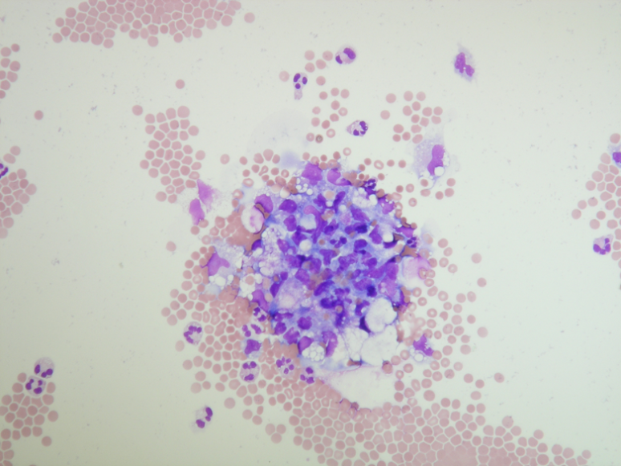
Secondary brain tumors II - MTS
25% of all brain tumors
MTS – not only tu brain tissue, also to meninges - meningeal carcinomatosis , malignant cell in CSF

Slide 6
Tumors of childhood
20% of all tumors – tumors of childhood
More frequently malignant than in adults
The most frequent localisation - infratentorial (brainstem, cerebellum).
Others - supratentorial

Slide 7
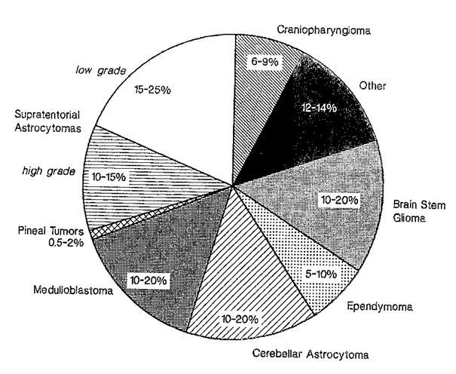
Distribution

Slide 8
Benign vs malignant?
According histological structure
biopsy - (cell atypia, mitotic activity, abnormal mitosis)
Location key!!!
Benign tumors in brainstem or deep structures – bad prognosis

Slide 9
Brain tumors classification
Neuroepitelial tumors
1. Astrocytoma
Astrocytoma
I, II benign
  III (anaplastic astrocytoma) - malignant
  IV (gliobastoma multiforme)
2. Oligodendroglial tumors
Oligodendroglioma
3. Ependymal tumors
Ependymoma

Slide 10
Brain tumors classification
4. Mixed gliomas
5. Neuroepitelial tumors – unknown
etiology
6. Chorioidal plexus tumors
Papiloma, papilocarcinoma
7. Neuronal and mixed neuronalglial tumors
8. Pineal parenchymal tumors
9. Tumors with neuroblastic or glioblastic elements
(embryonal tumors)
Meduloblastoma

Slide 11
Brain tumors classification
Other CNS tumors
1. Tumors of sellar region
1. Pituitary adenoma
2. Pituitary carcinoma
3. craniopharyngeoma
2. Hemopoietic tumors
1. Primary malignant lymphoma
2. Plasmacytoma

Slide 12
Brain tumors classification
3. Tumors from germinal cells
4. Meningioma
5. Non-meningotelial meningeal tumors
- malignant melanoma
- malignant lymphoma

Slide 13
Brain tumors classification
6. Tumors of cranial and spinal cord nerves
Neurinoma (Schwannoma)
Neurofibroma
7. Local tumors
Chondrosarcoma
Chondrocarcinoma
8. Metastatic tumors
9. Nonclassified tumors
10. Cysts

Slide 14
Clinical features
General symptoms
Intracranial hypertension syndrome
  Headache, vomiting, dizziness, blurred vision
  Papilledema (prominent optic disc at the fundoscopic examination)
  Dilatation of the pupils on the side of the lesion (anisocoria)
New onset of epilepsy
  Focal, Generalized
Altered state of consciousness
  Somnolence, coma
Psychological changes (behavioral problems)

Slide 15
Clinical features
Focal signs
Depends on the localisation of tumor

Slide 16
I. Neuroepitelial tumors
Astrocytoma
4 grades of malignity
  I, II benign
  III (anaplastic astrocytoma) – malignant
  IV (gliobastoma multiforme)
Adults
Frontal and temporal lobe
Rarely in childhood – pons

Slide 17
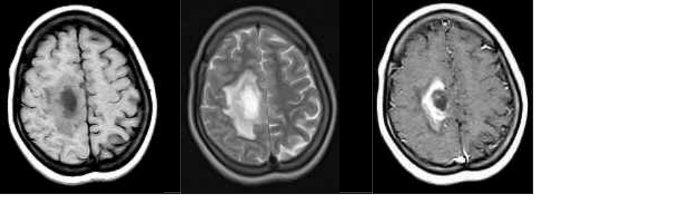
Astrocytoma
MRI T1 weighted T2 weighted flair

Slide 18
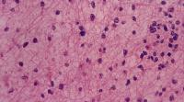
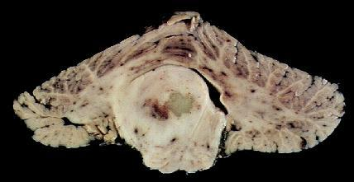
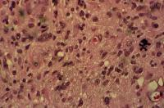
Astrocytoma
Astrocytoma – low grade – in pons
Anaplastic astrocytoma

Slide 19
Gliobastoma multiforme
The most malignant tumor of CNS
Rapid progression
5th & 6th decade , men 2x more often
Deep part of hemispheres (basal ganglia, tallamus, white matter)
Spreading by CSF, infiltration of corpus callosum, spreading on the other side, infiltration of meninges)
MTS also outside of CNS
CT scan – cystic, necrosis, heamorrhages

Slide 20
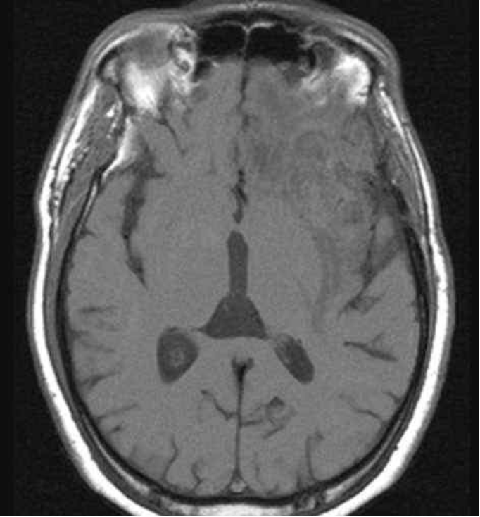
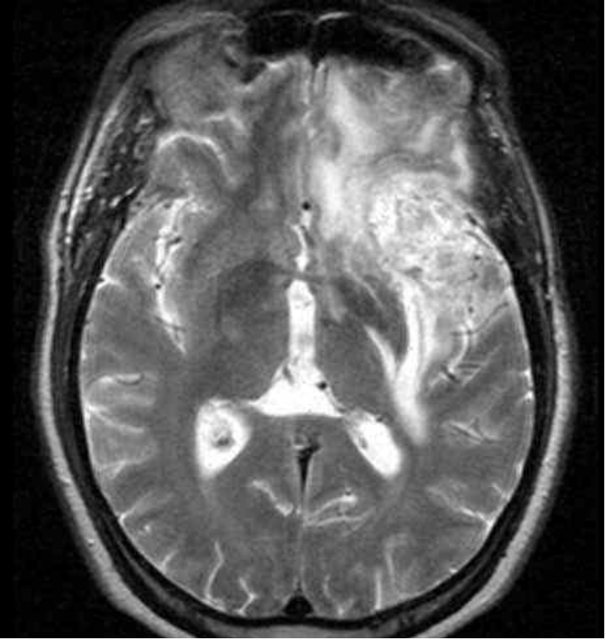
Glioblastoma multiforme
MRI T1 weighted T2 weighted

Slide 21
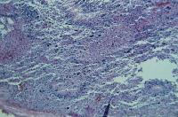
Glioblastoma multiforme
Frequent mitosis
Atypic cells
Neovascularisation
Bleeding

Slide 22
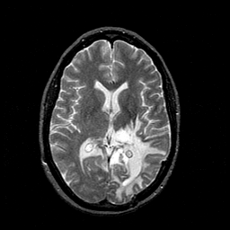
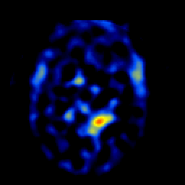
Glioblastoma multiforme
MRI T2 weighted SPECT

Slide 23
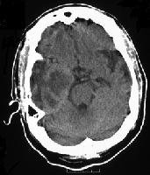
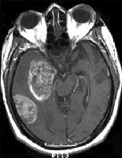
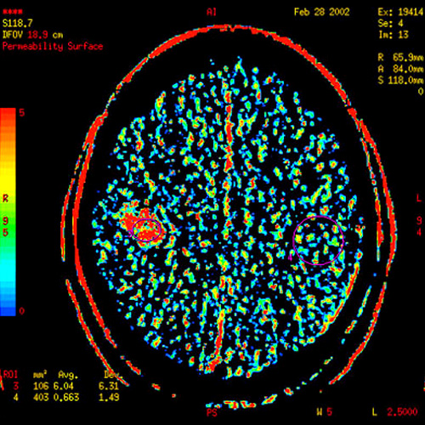
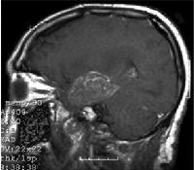
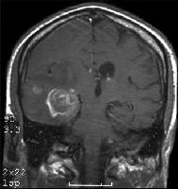
Glioblastoma multiforme

Slide 24
I. Neuroepitelial tumors
Oligodendroglial tumors
Common in Adults
Frequently with calcifications
Frontal lobe
5% of CNS tumors
Low % is histological malignant

Slide 25
I. Neuroepitelial tumors
Ependymal cells tumors
4% of CNS tumors
Occur in Adults and children
4th Ventricle – obstructive hydrocephalus
Spreading by CSF
MTS in CNS

Slide 26
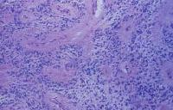
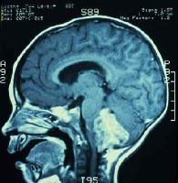
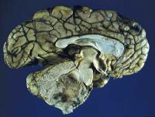
Ependymoma

Slide 27
I. Neuroepitelial tumors
plexus choroideus tumors
Papiloma or papilocarcinoma
Rare
Occurrence - Childhood
Ventricles
Hydrocephalus

Slide 28

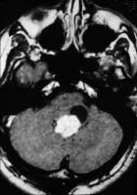
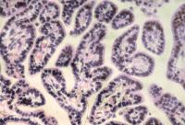
Plexus choroideus tumors
MRI histology

Slide 29
I. Neuroepitelial tumors
Neuroectodermal tumors
Childhood
High grade of malignity
  MEDULOBLASTOMA
  23% of CNS tumors in childhood
  Vermis, cerebellar hemispheres
  Rapid progression, compression of CSF athways, intracranial hypertension
  MTS in brain and outside of CNS – bones, lymphatic nodes

Slide 30
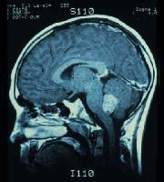
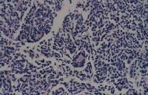
Meduloblastoma

Slide 31
4. Tumors of the meninges
Meningioma
15% of brain tumors
Localisation - hemispheres convexity, parasagital, n. olfactorius, sella turcica, pontocerebellar angle, tentorium
Benign
Bone usuration or hyperostosis

Slide 32
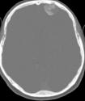
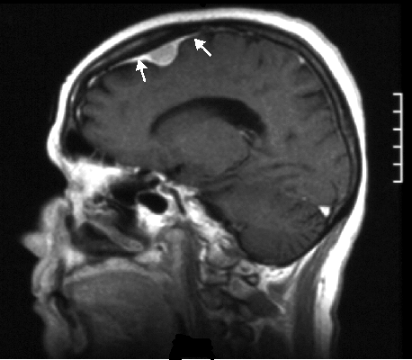
Meningioma
CT MRI T1 weighted

Slide 33
Meningioma
Parasagital
  Monoparesis of contralateral lower extremity or paraparesis
Near bulbus olfactorius
  Unilateral anosmia
Near optic nerve
  Exophtlamus, monocular blindnsess, ipsilateral mydriasis with absent light reflex

Slide 34
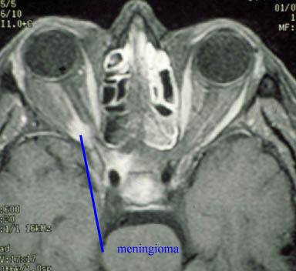
Meningioma
Meningioma near optic nerve on the right side

Slide 35
Meningioma
Near sphenoidal bone wings
  Epileptic seazures, lesion of cranial nerves – process near fissura orbitalis superior
Pontocerebellar angle
  Loss of hearing, dizziness, Bells palsy

Slide 36
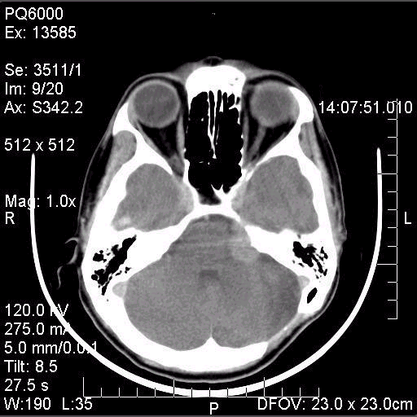
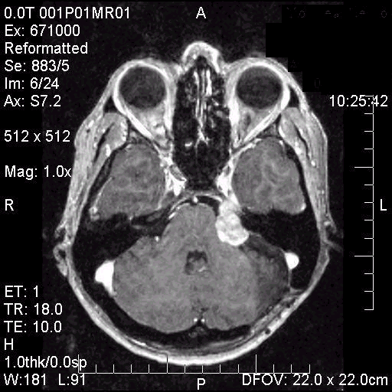
Brain CT – PCA meningioma

Slide 37
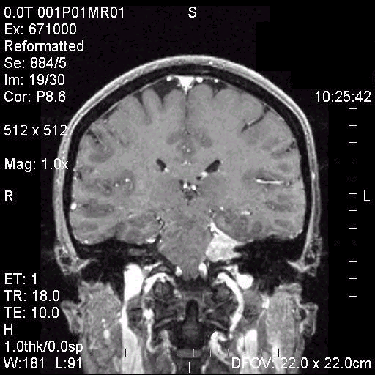
Brain CT - PCA meningioma

Slide 38
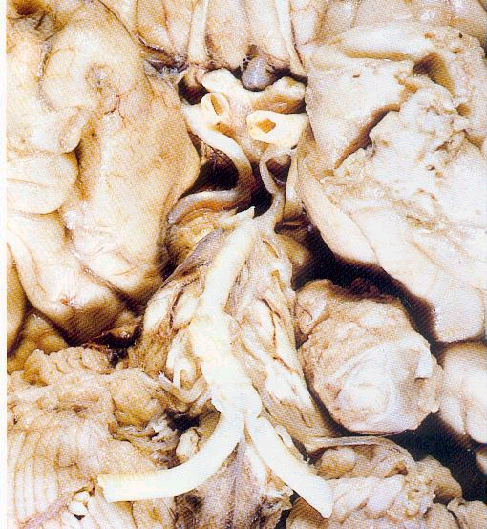
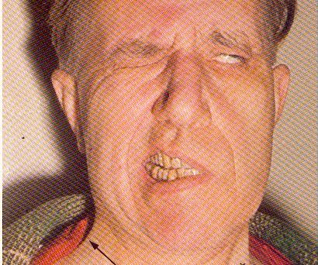
PCA meningioma

Slide 39
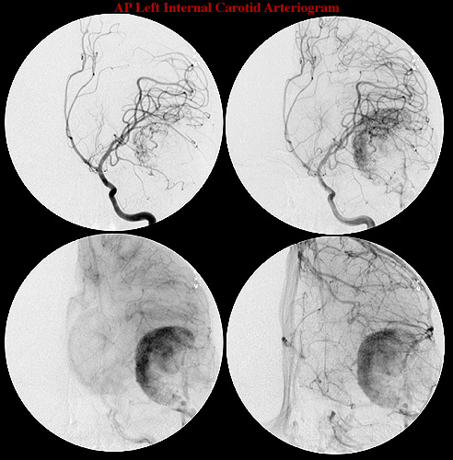
Meningioma
Angiography

Slide 40
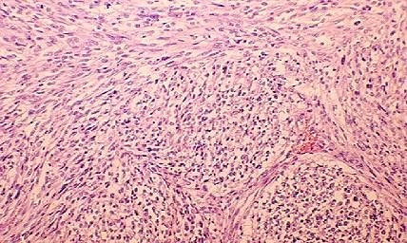
Meningioma
Histology

Slide 41
Tumors of sellar region
Adenoma, adenocarcinoma
Chiasma opticum compression – bitemporal hemianopsy
Endocrinne lesions
Skull X-ray – enlargment of sella turcica

Slide 42
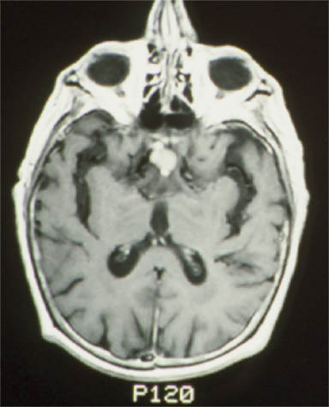
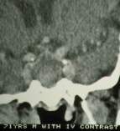
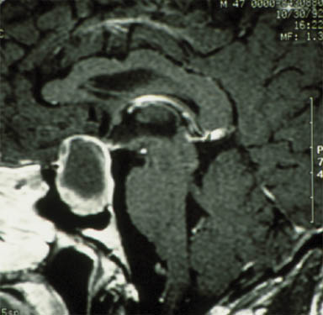
Tumors of sellar region

Slide 43

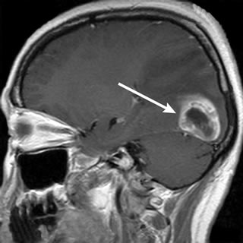
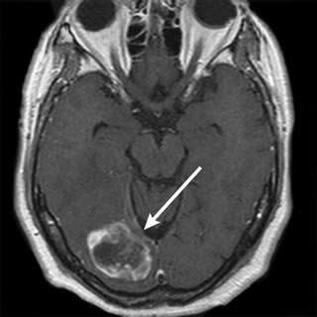
Secondary tumors
CT MRI

Slide 44
Diagnosis
Slowly progressive focal neurological signs and signs of intracranial hypertension, epilepsy in a patient with negative history of epilepsy
Optic fundus (oedema)
Imaging
  CT
  MRI
  Skull X-ray
Angiography
EEG, Histological examination of brain tumor tissue samples obtained either by means of brain biopsy or open surgery – definitive diagnosis

Slide 45
Therapy
Surgery
  Classical
  Gamma knife
Conservative
  Radiotherapy
  Chemotherapy
  Therapy of ICH and symptomatic therapy

Slide 46
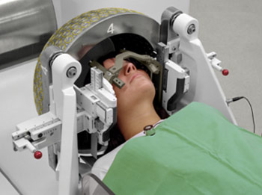
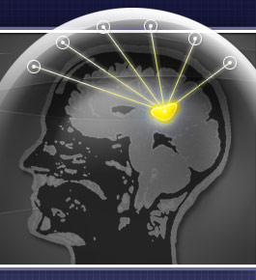
Gamma knife

Slide 47
Pseudotumor cerebri
Idiopatic intracranial hypertension
Intracranial hypertension syndrome without tumor
Papilledema (prominent optic disc at the fundoscopic examination)
Women of middle age – more often
After head injury
Therapy – kortikosteroids, antidiuretics?

Slide 48
Paraneoplastic syndromes
Disease or symptom that is the consequence of the presence of cancer in the body, but is not due to the local presence of cancer cells
These phenomena are mediated by humoral factors (by hormones or cytokines) excreted by tumor cells or by an immune response against the tumor
Middle aged to older patients
The most commonly - cancers of the lung, breast, ovaries or lymphatic system (a lymphoma), also stomach, ovaria, prostata

Slide 49
Paraneoplastic syndromes
Sometimes the symptoms of paraneoplastic syndromes are present even before the diagnosis of a malignancy
6,6% - 10% patients with tumors
Antibodies against neuronal structures (anti Yo, anti Hu, anti Ri)

Slide 50
Paraneoplastic syndromes
All parts of nervous system
  Central NS
  Periferal NS
  Neuromuscular junction
  Muscles

Slide 51
Paraneoplastic syndromes
Small cell lung carcinoma
Breast carcinoma
Ovarial carcinoma
Hodgkin lymphoma
Tymoma
Neuroblastoma
Prostatic carcinoma

Slide 52
Paraneoplastic syndromes
Central nervous system
  Multifocal encephalomyelitis
  Cerebellar degeneration
  Limbic encephalitis
  Opsoclonus-myoclonus
  Extrapyramidal syndrome
  Brain-stem encephalitis
  Necrotizing myelopathy
  Motor neuron disease
  Stiff person syndrome
  Optic neuritis
  Retinal degeneration
Peripheral nervous system
  Sensory neuronopathy
  Nerve vasculitis
  Sensorimotor polyneuropathy
  Motor neuropathy
  Neuromyotonia
  Autonomic insufficiency
  Lambert–Eaton syndrome
  Inflammatory myopathy
  Necrotizing myopathy

